Slide 1
Network team Multi path czm
Jianming zeng

Slide 2
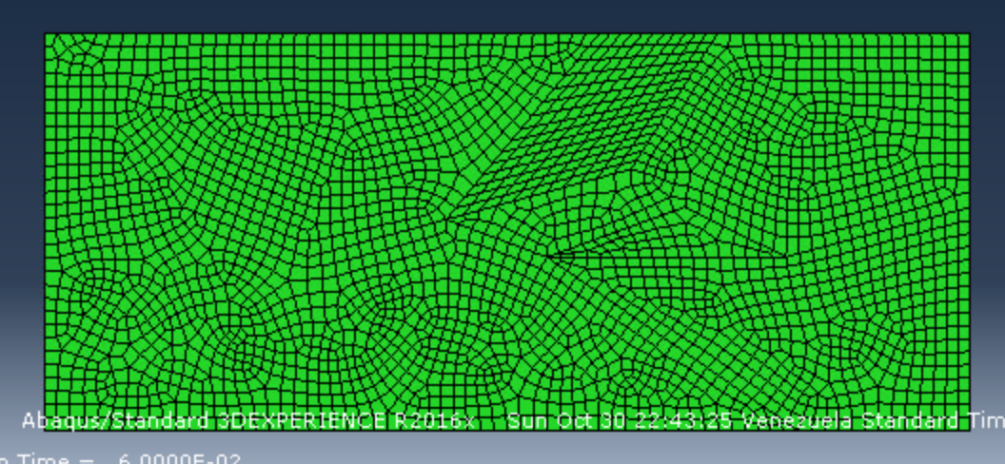
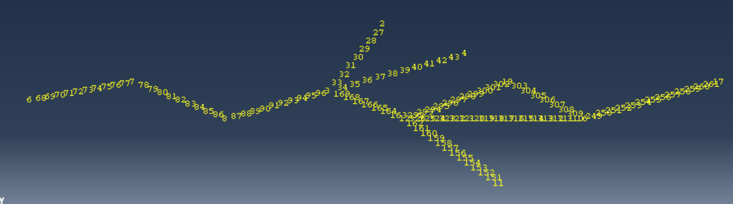
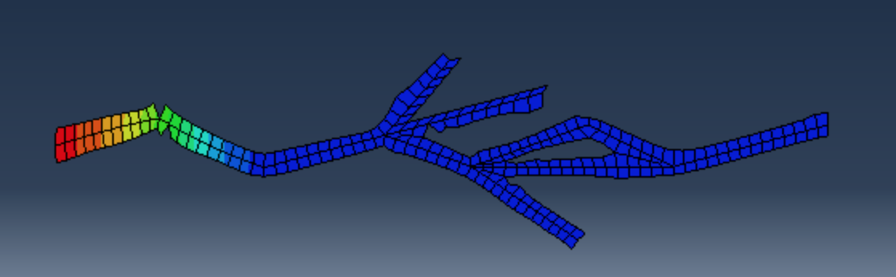
Background

Slide 3
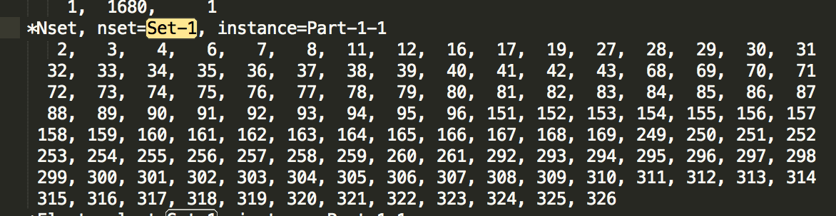
Data file

Slide 4
Sub tasks
Sort the given list of nodes such that neighbor nodes are next to each other
Data structure for storing information
How to establish pair-wise relationship
2. Add cohesive elements appropriately (ongoing)
Finding the exact locations(identifier)
Update appropriately

Slide 5
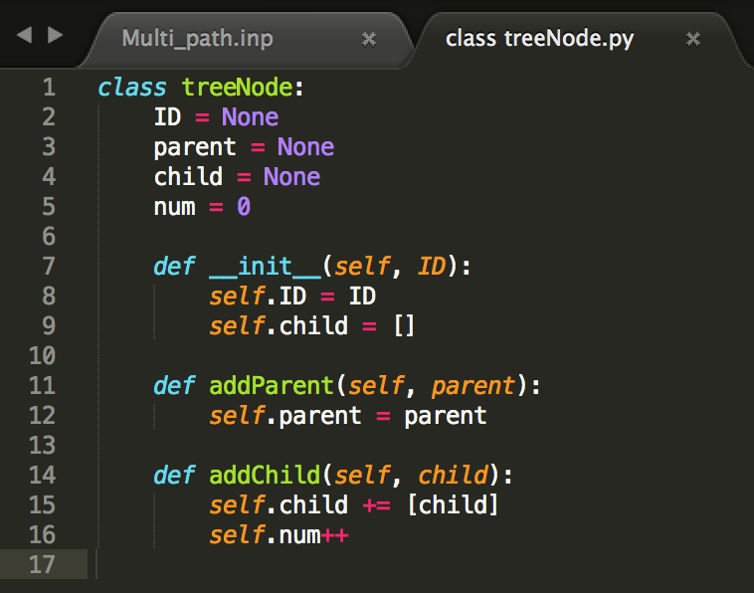
Why ADT TREE?

Slide 6
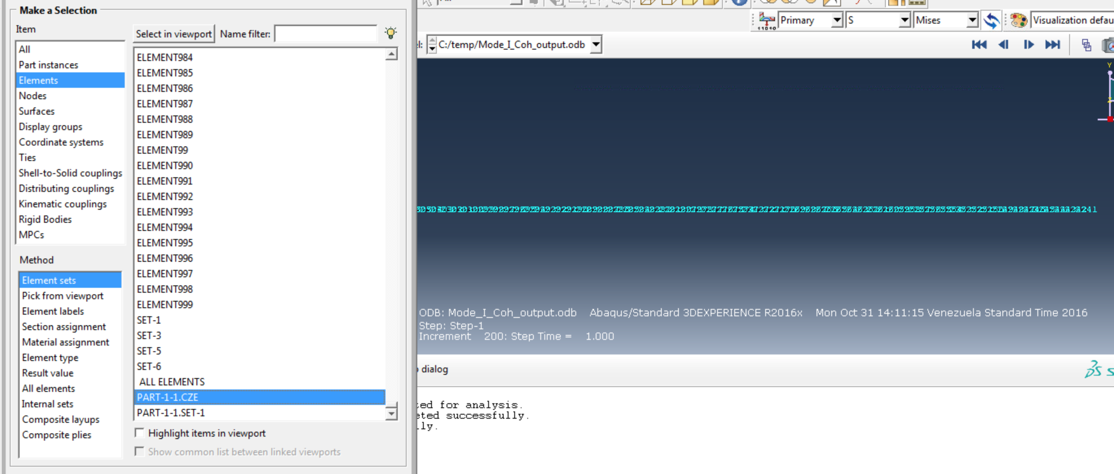
Results on single crack

Slide 7
Multi crack analysis
Possible error 1:
In single crack model, there is one and only one tree root and leave, no convergence or divergence. But in mutil crack model, any tip could be a tree root or a leave. Both convergence and divergence e.

